Slide 1
Ice Breakers What is your name? Tell me something interesting about yourself.

Slide 2
Using Positive Psychology to Enhance Student Success
Dr. Marsha Fralick

Slide 3
PowerPoint and Handouts posted online at: http://www.collegesuccess1.com/spc.html See Handout

Slide 4
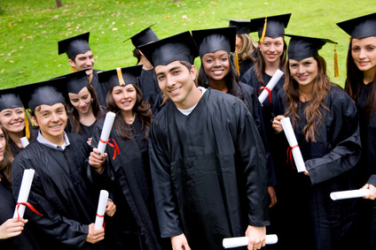
How does it relate to student success?
Notes:
Typical goals: I want to be happy in life.
Typical career choice: I want a career that makes me happy.

Slide 5
What is positive psychology?
Highlights from: A Primer in Positive Psychology by Christopher Peterson

Slide 6
Positive psychology is the scientific study of what goes right in life.
Named by Martin Seligman, president of the American Psychological Association, 1998

Slide 7
Focus
Psychology
Focus on weakness
Relieving distress
Curing illness
Positive Psychology
Focus on strengths
Building the best in life
Fulfillment

Slide 8
Basic Ideas
People matter.
Money cannot buy happiness.

Slide 9
Components of Positive Psychology
Positive subjective experiences: happiness, pleasure, gratification, fulfillment
Positive individual traits: strengths of character, talents, interests, values
Positive institutions: families, schools, business, communities, societies

Slide 10
Love and happiness is not reserved for the lucky or the strong. It can be attained by hard work and may entail careful deliberation and awkward action.
Notes:
Life is drawing without an eraser.

Slide 11
Positive Emotions Enhance Learning
Better attention
Memory improvement
Greater verbal fluency
Increased openness to information
Notes:
Example: Art Class

Slide 12
Negative Emotions
Signal danger
Focus on the here and now to find safety
Positive emotions help to plan the future.
Notes:
Example: Onions award

Slide 13
Positive Psychology and Teaching
Fear is the root of academic failure.
It inhibits new learning and blocks intrinsic motivation.

Slide 14
Positive Psychology and Teaching
Move from avoiding failure to expecting success.
Help students feel emotionally safe.
Encourage positive self-narrative.

Slide 15
Examples: Using Psychology in Teaching
Setting the tone.
Start class on a positive note.
Responding to students.
Providing feedback on assignments.
Build on strengths.
Build interest.
Notes:
Expectations for behavior
Begin the class with a check-in.
What is something good that happened to you since the last class?
What is distracting you from being fully present is class today?
Do you have any news to share with the class?
Thank you for your answer. Does anyone want to add to that?
That’s an interesting idea. What do the rest of you think about it?
That’s a controversial topic. Does someone have a different point of view?
Thanks for getting the discussion going.
This is the good part. Here are some suggestions for improvement.
Provide alternate ways of completing assignments so students can build on strengths. Alternate activities: Audio, Visual, Kinesthetic, Tactile
Keep it moving. Change every 10-15 minutes.

Slide 16
Happiness A field within positive psychology
Highlights from Authentic Happiness by Martin Seligman

Slide 17
Happiness is . . .
Think
Pair
Share
Besides friends and family, happiness is . . . .

Slide 18
Many students confuse hedonism with happiness.

Slide 19
Hedonism Vs. Happiness
Hedonism
Happiness
Maximizing pleasure and minimizing pain
Immediate gratification
Identifying one’s values and acting on them
Self-actualization
Maybe life involves a little of both, but not hedonism only.

Slide 20
Hedonist Adaptation
We assume that more material possessions will make us happy, but the more material possessions, the greater the expectations, and we no longer appreciate what we have.

Slide 21
Hedonism is a shortcut to happiness that leaves us feeling empty.

Slide 22
Real happiness comes from identifying, cultivating and using your personal strengths in work, love, play and parenting. -Martin Seligman

Slide 23
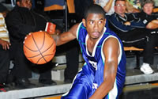
Being in the Flow
Related to happiness
Sports:
“Being in the zone”
The psychological state that accompanies highly engaging activities
Engagement!

Slide 24
Being in the flow
Most likely to occur when there is optimal balance between skill and challenge
These activities leave us invigorated and satisfied
Result in positive emotions

Slide 25
Formula for Happiness
Happiness = S + C + V
S: Set Range:50% determined by heredity
C:Circumstances: about 10% of happiness
V: Voluntary Control: 40% of happiness

Slide 26
3 Good Things
Think
Pair
Share
What are 3 good things that happened last week?

Slide 27
Suggestions for Improving Happiness

Slide 28
Realize that the past does not determine your future. The future is open to new possibilities.

Slide 29
Be grateful for the good events of the past and place less emphasis on the bad events.
Notes:
If you could write a journal with one good thing that happened each day, you would change your thought patterns to be more positive.

Slide 30
Build positive emotions through forgiving and forgetting.

Slide 31
Work on increasing optimism and hope for the future.
Notes:
Hope for the future is one of the most important factors influencing future success.

Slide 32
Find activities that make you happy and engage in them.
Notes:
Sprinkle these activities out over time so you do not get tired of them.

Slide 33
Take the time to savor the happy times. Make mental photographs of happy times so you can think of them later.
Notes:
Power of visualization

Slide 34
Take time to enjoy the present moment.

Slide 35
Build more flow into your life.

Slide 36
Express gratitude.
Notes:
Create a gratitude journal and at the end of the day write down things for which you are grateful or thankful. Being grateful helps us to savor positive life experiences.

Slide 37
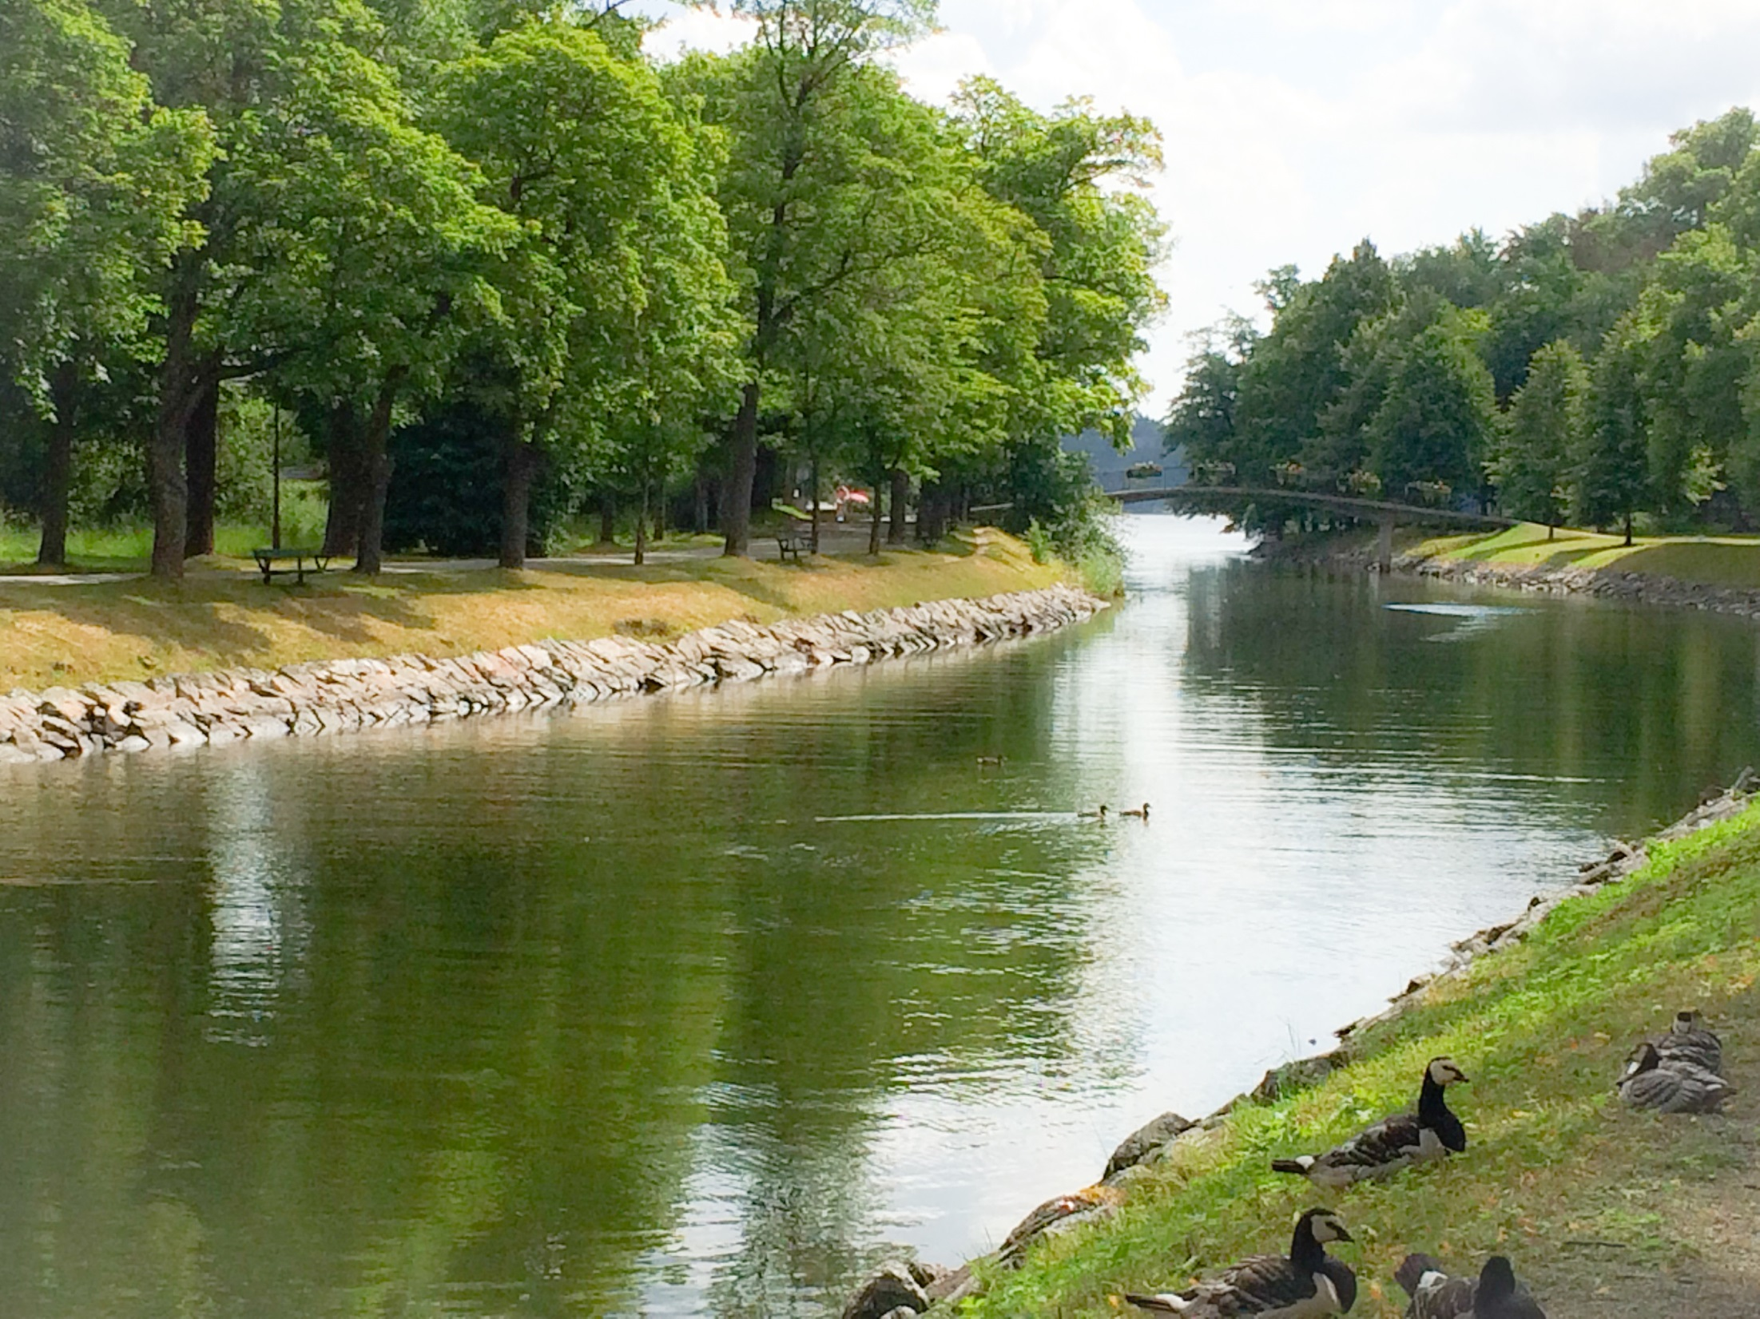
Avoid over-thinking and social comparison.
Notes:
Overthinking is focusing on yourself and your problems needlessly and excessively. Examples:
Why am I so unhappy?
Why is life so unfair?
Why did he/she say that?
Overthinking increases sadness, decreases motivation and makes it difficult to take actions to make life better.

Slide 38
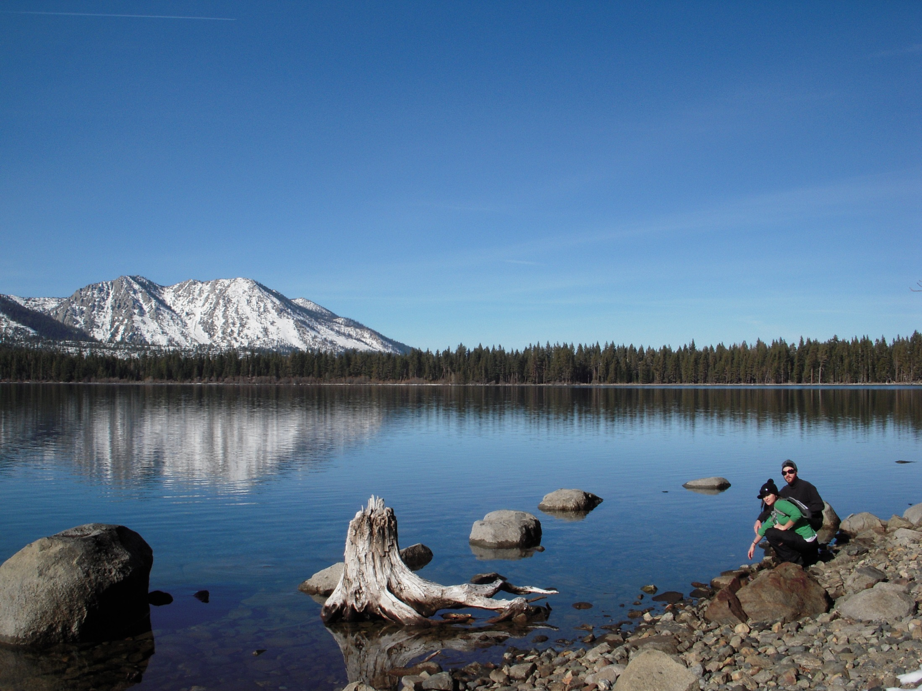
Practice acts of kindness.
Notes:
Doing something kind for others increases your own personal happiness and satisfies your basic need for human connection.
How about being courteous on the freeway?
Helping your elderly neighbor with yard work?
This often sets of a chain of events in which the person helped does something kind for someone else.

Slide 39
Commit to accomplishing your goals.
Notes:
Working toward your meaningful life goals is one of the most important things you can do to have a happy life. Goals provide structure and meaning to our lives and improves self-esteem.

Slide 40
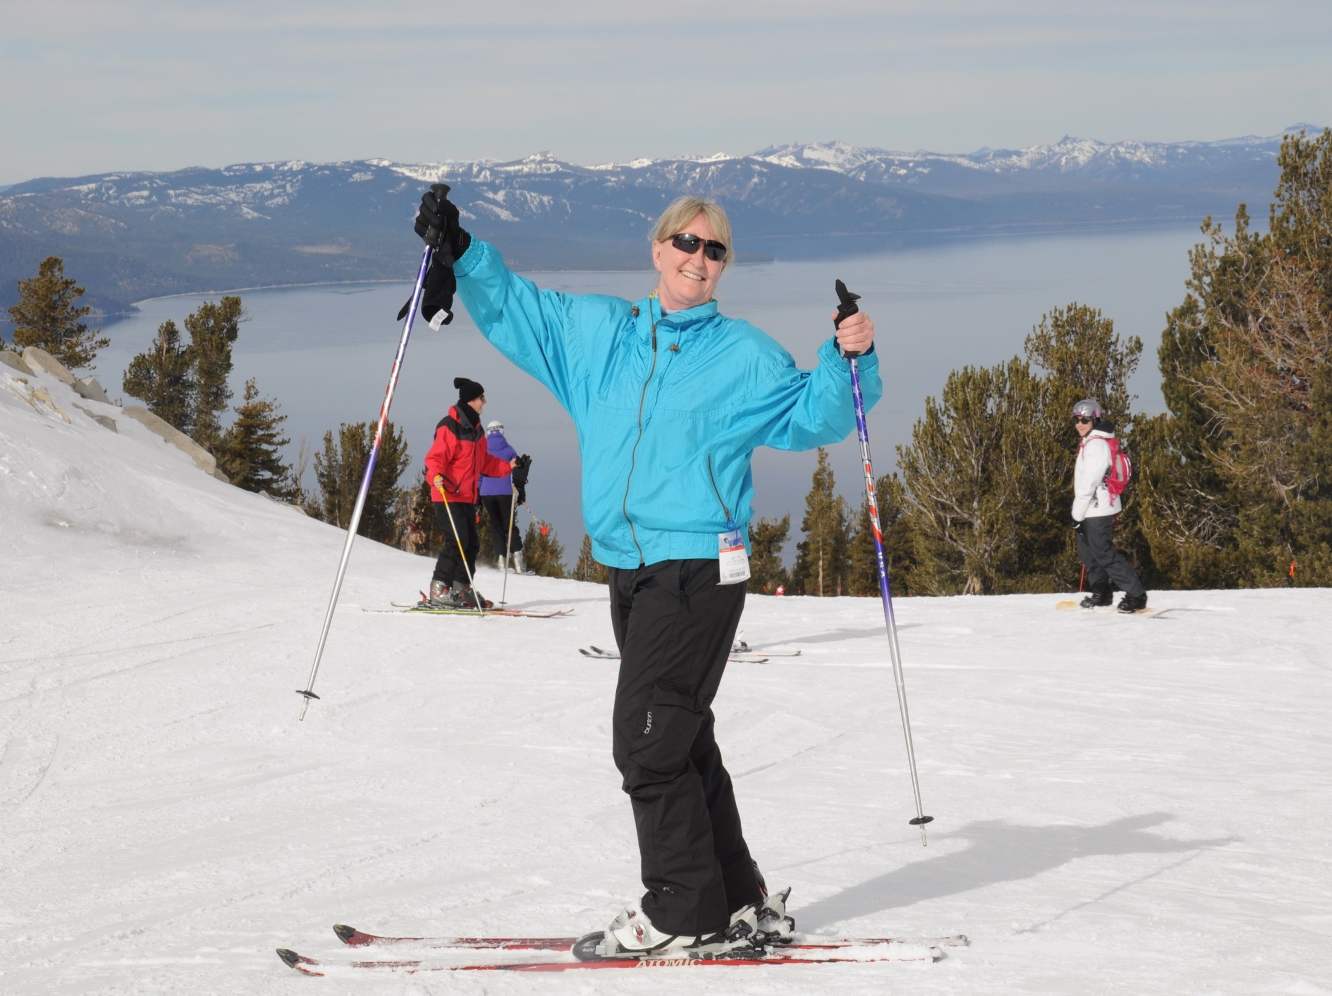
Maintain a healthy lifestyle.
Take care of your body.
Notes:
Exercising helps to focus the mind by only paying attention to the task at hand.
Increase longevity
Improve sleep
Keep brain healthy
Increase self-esteem
Provide a distraction from worries

Slide 41
Improving Retention and Success

Slide 42
Making the Most of the First Week of Your Course

Slide 43
The first week sets the stage for all that follows.

Slide 44
Start with Engagement
Do an engaging and enjoyable activity so that students leave the first class with enthusiasm for the course.
The Snowball Activity

Slide 45
Pace Your Class
Spend no more than 10-15 minutes on any one activity.
Plan activities that require student interaction.
Move them out of their seats.

Slide 46
Student Engagement Effective Groups: Preview the Topic

Slide 47
Supportive Learning Environment
Positive feedback:
Examples
I believe that students learn better in a positive and supportive environment. It is my goal to be supportive of your learning and encourage you to be supportive and respectful of other students.

Slide 48
Introduce Yourself
Your educational journey
Your most important values
Why you enjoy teaching this course
What you hope students learn in the course
Your professional experience
Your favorite inspirational quote
Keep it short!

Slide 49
Introductions
Get to know your students and help students get to know one another.

Slide 50
The Syllabus
Don’t read your syllabus to the class!
What are some interesting ways to present your syllabus?
Think, Pair, Share

Slide 51
Behavior
Set the standards for appropriate behavior and enforce them from the first day.

Slide 52
Improving Attendance Free writing

Slide 53
The Critical Period: The first 2 weeks
Attendance
Engagement
Completion of the first assignment
Follow-up for those who have not completed it

Slide 54
Flipping Your Classroom to Improve Student Success and Engagement

Slide 55
What is a flipped classroom?

Slide 56
It involves rearranging the typical events in a classroom.

Slide 57
Key Idea: Read the assignments before the class begins. Verify that the reading has been done.

Slide 58
Benefits for Students
More actively engaged in learning
Assume more responsibility for their learning
More opportunity for practice and learning from others
Get in the habit of pre-reading textbooks which is critical in more challenging courses

Slide 59
Benefits for Faculty
Change roles from lecturer to coach or guide
Freed from repetitive classroom lectures
Additional time for collaborative learning and social interaction

Slide 60
What did you like? What can you use next semester? Think, Pair, Share

